Slide 1

Attitudes and stereotypes: Tripartite Model of attitude formation
AEPSY Year 11 ATAR Psychology

Slide 2
Review
Explain the difference between implicit and explicit attitude
Define implicit bias and explain it in the context of racism
List 10 factors that can influence formation of attitudes.
Define schema
Define subjective.

Slide 3
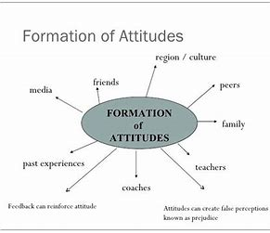

Slide 4
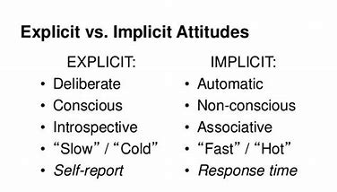

Slide 5
Learning Intentions
Tripartite model of attitude structure – affective, behavioural, cognitive

Slide 6
Success Criteria
List the three aspects of the Tripartite (ABC) model of attitude.
Distinguish between attitude, belief and value.
Define affective, behavioural and cognitive.
Give example of affective, behavioural and cognitive attitudes.

Slide 7
Attitude
A cognitive schema relating to an object, person, group, issue, or concept.
Can be negative or positive.
A subjective belief.

Slide 8
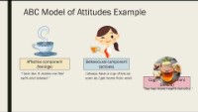

Slide 9
The Tripartite Model of Attitude Formation (ABC)
A theory of attitude structure postulating which an outlook is based upon or contains affective, behavioral and cognitive elements.
Affective Attitude – how we feel about something.
Behavioral Attitude – what we do about something.
Cognitive Attitude – how we think about something.

Slide 10
A
The affective component of attitude refers to how we feel about something. It’s often our initial reaction and might be positive or negative, such as a fear-based reaction or an excitement-based reaction.
Being excited about a song because it reminds us of a loved one.
Being repulsed by a smell because we have associated it with a bad memory.
Being afraid of a lion because we’ve never seen one before.

Slide 11
B
The behavioral component of attitude refers to our intentions, or what we would do.
It can be informed by our attitude or cognition. For example, if we’re afraid of something (our affect), we might run (our behavior).

Slide 12
C
Our cognitive component is what we think about something.
Cognitive and affective components are interrelated, but don’t always overlap.
For example, we might think it’s a bad idea to take a holiday, even though we have positive feelings about it, because it’s too expensive. That’s because we’re overriding our impulsive feelings in order to make decisions based on logic.

Slide 13
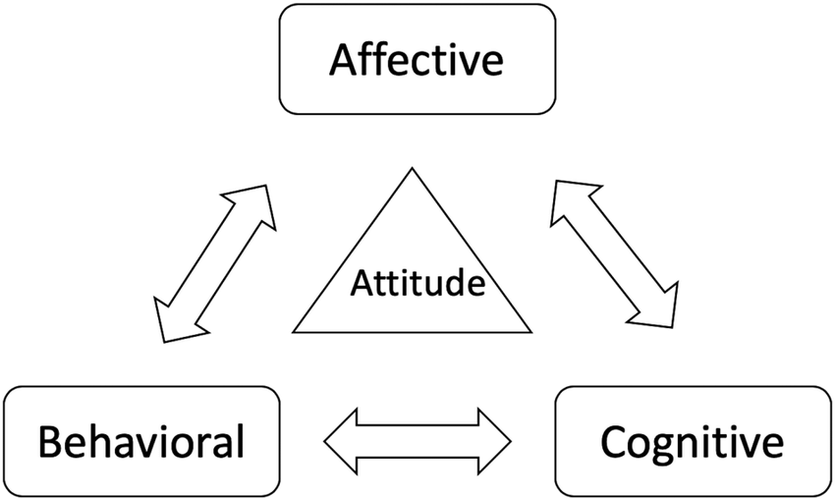
Affect, behavior or cognition could each win out in a decision. This changes depending on the situation.

Slide 14
Success Criteria
List the three aspects of the Tripartite (ABC) model of attitude.
Distinguish between attitude, belief and value.
Define affective, behavioural and cognitive.
Give example of affective, behavioural and cognitive attitudes.

